Slide 1
An Exploration of the Effect of Buyer Preference and Market
Composition on the Rent Gradient using the ALMA Framework
Alexander Michels^{1,2,3}, Jeon-Young Kang⁴, and Shaowen Wang^{1,2,3}
¹ Illinois Informatics Institute
² CyberGIS Center for Advanced Digital and Spatial Studies
³ University of Illinois at Urbana-Champaign
⁴ Kongju National University Gongju-si, Chuncheongnam-do, South Korea
3rd ACM SIGSPATIAL International Workshop on GeoSpatial Simulation (GeoSim'20)
November 3–6, 2020, Seattle, WA, USA
Notes:
I’m Alex Michels
2nd year PhD student in Spatial Informatics at UIUC working under Dr. Shaowen Wang
Title

Slide 2
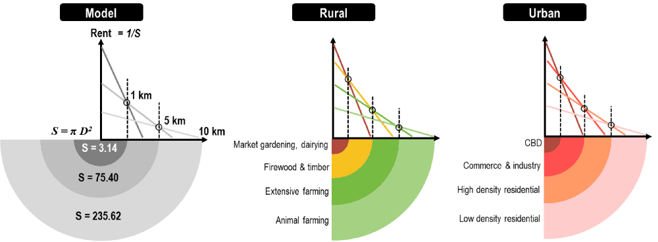
Bid-Rent Theory
Image Source: https://doi.org/10.1007/978-3-030-26626-4_16
Notes:
Bid-rent theory is a theory that describes how rent and demand for land increases as proximity to a central business district increases.
Examples with rural and urban

Slide 3
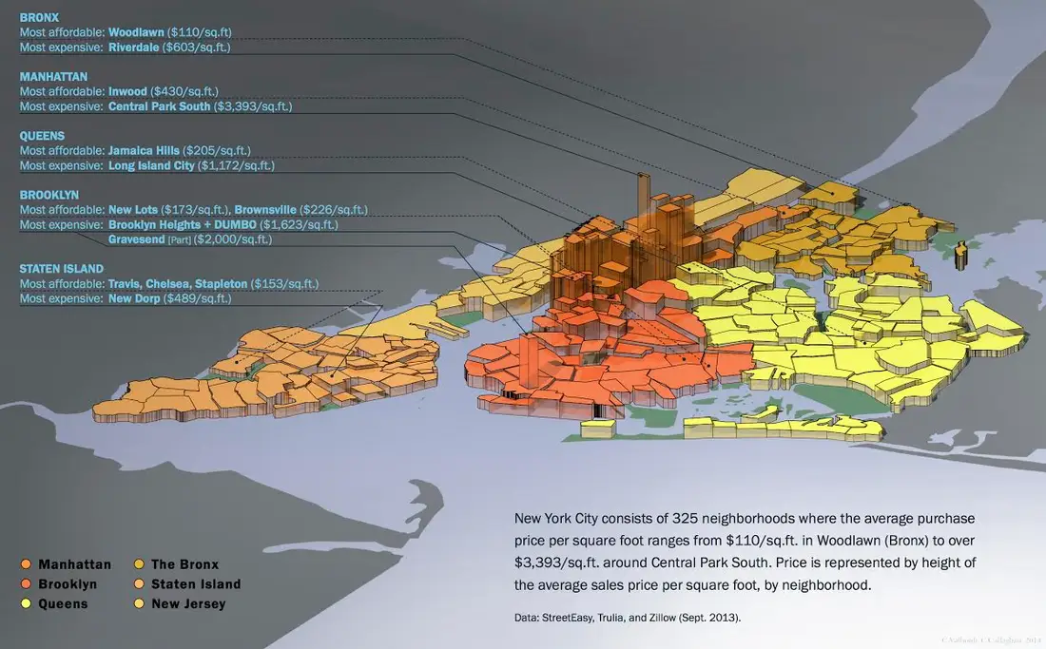
Bid-Rent IRL
Bid-Rent is generally a decent predictor, but not entirely accurate.
Image Source: https://www.businessinsider.com/new-york-city-real-estate-prices-3d-map-2015-1
Notes:
Highest prices in Manhattan where Wall Street and lots of finance takes place
There are anomalies like Central Park South (largely residential) and Gravesend in Brooklyn.

Slide 4
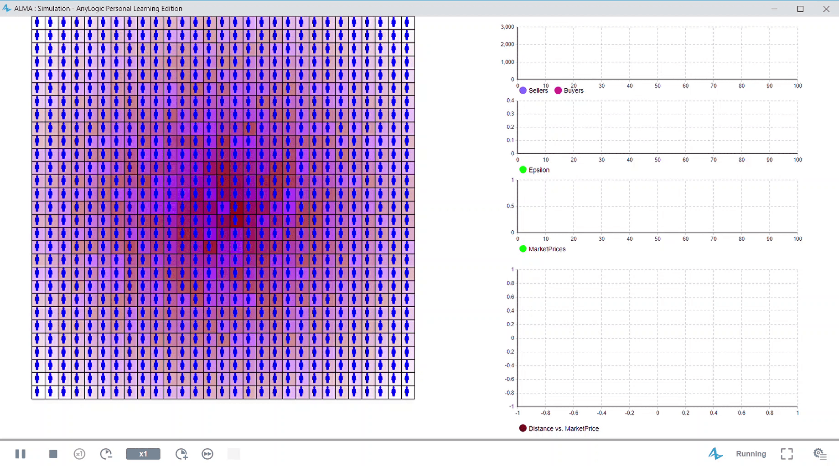
Agent-based Land MArket (ALMA)
work done by Tatiana Filatova, Dawn Parker, and Anne van der Veen
Papers: https://doi.org/10.1016/j.compenvurbsys.2008.09.012 and http://jasss.soc.surrey.ac.uk/12/1/3.html
Notes:
This gif is from my implementation

Slide 5
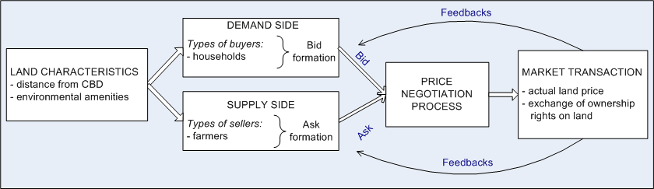
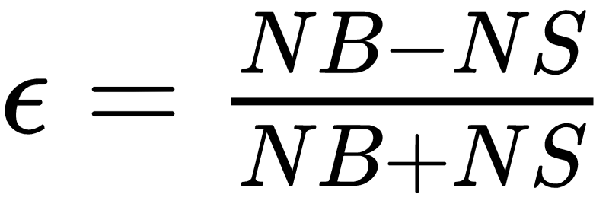
Model Overview
Image Source: http://jasss.soc.surrey.ac.uk/12/1/3.html
Notes:
Big innovation of ALMA: bilateral market, represents both supply and demand.
Part of “feedbacks”: Epsilon tells market type:
Represents % adjustment to your bid/asking price based on market circumstances
NB = number of buyers
NS = number of sellers
If NB > NS -> epsilon > 0 -> seller’s market
If NS > NB -> epsilon < 0 -> buyer’s market
We will get into specifics shortly

Slide 6
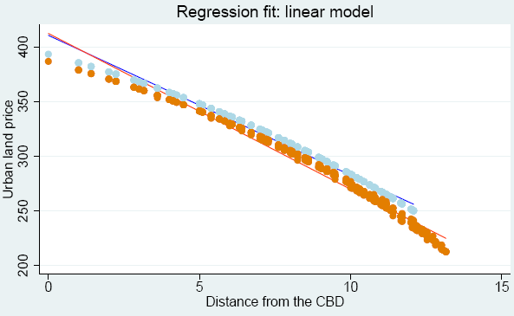
ALMA Results
ALMA was able to produce a rent gradient, measured by the linear regression between land value and proximity.
Image Source: http://jasss.soc.surrey.ac.uk/12/1/3.html

Slide 7
ALMA’s Assumptions
All agents have identical preferences and budgets
This means all utility functions are the same
All cells have the same level of environmental amenities
This means buyers never face a trade-off between amenities and proximity. Therefore they will always seek to maximize proximity and disregard amenities entirely.

Slide 8
Does the ALMA model work under diverse buyer preferences and market compositions?

Slide 9
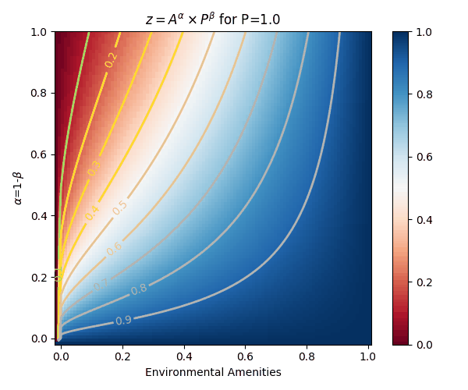
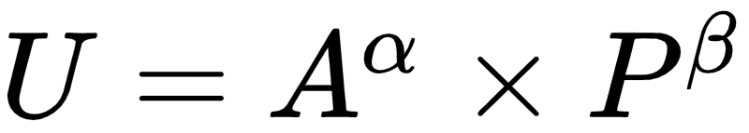
Utility in ALMA
Preference for Green Amenities
Preference for Proximity
Utility
(Usefulness)
Green
Amenities
Normalized
Proximity
Notes:
They used:
A = 1
alpha=0.15, 0.3
beta=0.85,0.7

Slide 10
Weakening Assumptions
Heterogeneity in Buyers:
The preference for amenities is drawn from a uniform distribution [ 0, ɑ_{max} ].
The housing budget is drawn from a uniform distribution [ 800, 1000 ]
Variation in Cells - amenities are uniformly distributed [ 0, 1 ].
Tested a wider variety of market compositions
Parameterized ratio between number of buyers and sellers → Buyer Level
Notes:
Introduced heterogeneity to the Buyers:
Buyers now have different preferences and goals
Buyers have slight variation in their budget -> more realistic
alpha-max is a new parameter. Easy way to control the alpha and beta distributions
Allowing level of amenities to vary means there will be trade-offs between proximity and amenity!
Buyer Level parameters
Why didn’t they have this heterogeneity?
Used the representative agent approach, which is now largely debunked.
Jackson and Yariv (2017) proved that representative agents for commonly used utility functions do not exist, and thereby typical macroeconomic models are not actually micro-founded.

Slide 11
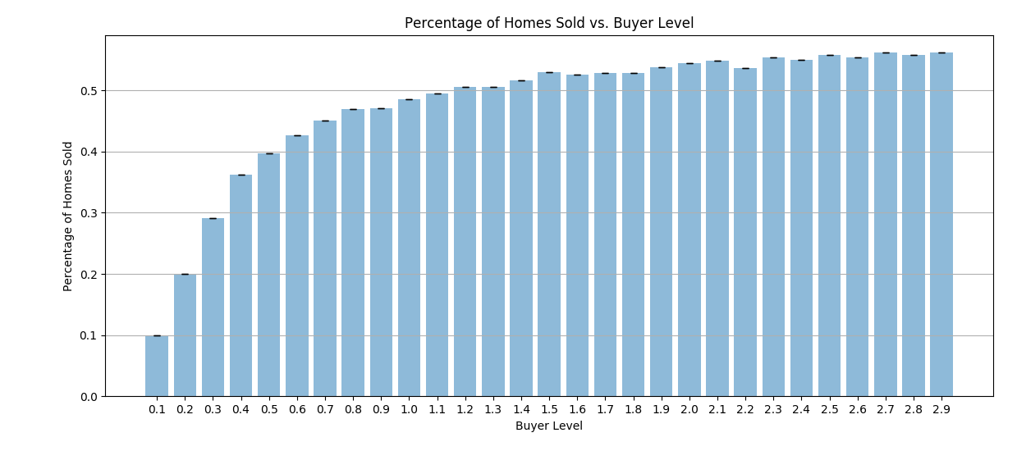
Percentage of Homes Sold
Notes:
Recap: Buyer level is (number of buyers)/(number of sellers)
1-to-1 relationship early on, diminish returns as Buyer Level increases. More competition for central cells and a higher

Slide 12
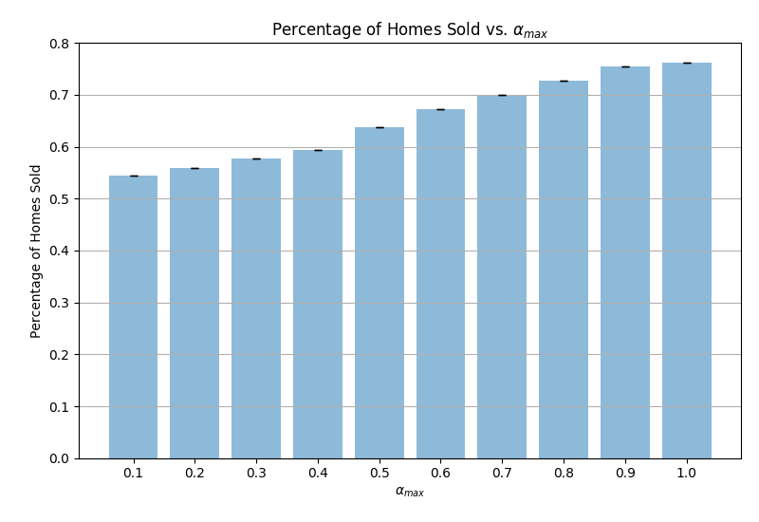
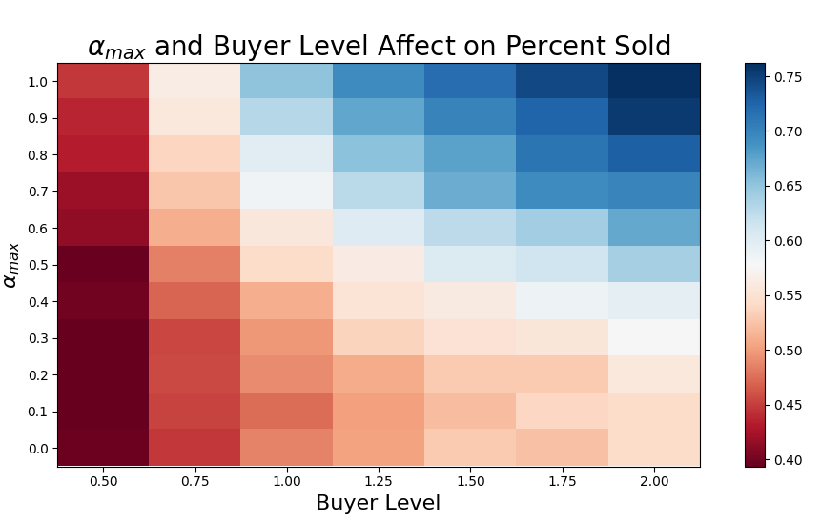
⍺_{max} and ⍺_{max} with Buyer Level vs. % Sold
Notes:
Recap: alpha_max is max value of the uniform distribution of alpha. Alpha is the preference for amenities
Number of homes sold increases as alpha_max increases. Not super surprising: diverse preferences lead to selling a more diverse array of homes
Vary both at the same time: nothing too surprising. There appears to be little interaction between a_max and BL as it pertains to % sold.

Slide 13
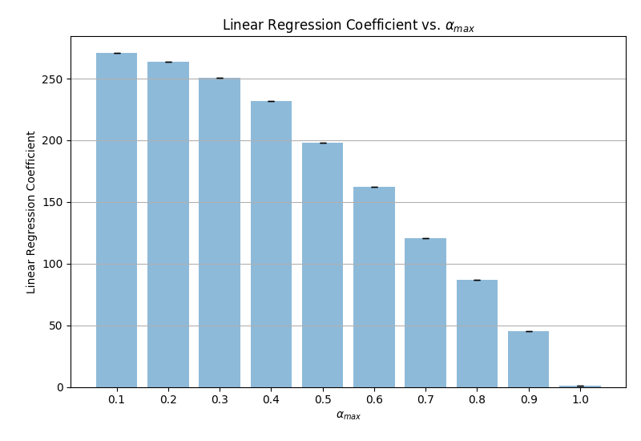
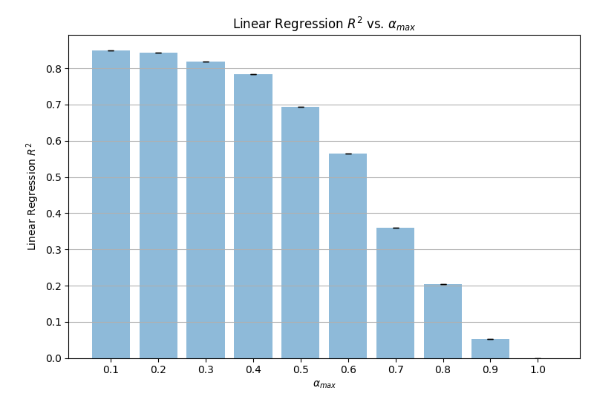
How is the rent gradient is affected by 𝞪_{max}?
Notes:
Regression coefficient: added value of proximity
R^2 adherence to the rent gradient
As alpha_max increases, the linear regression coefficient and R-squared fall. Not very surprising because as alpha_max goes to one, the mean alpha tends to .5 as does mean beta. Thus agents care about both amenities and proximity equally.
Interesting that the decline happens so quickly (mean beta at alpha_max=1 is still .5)

Slide 14
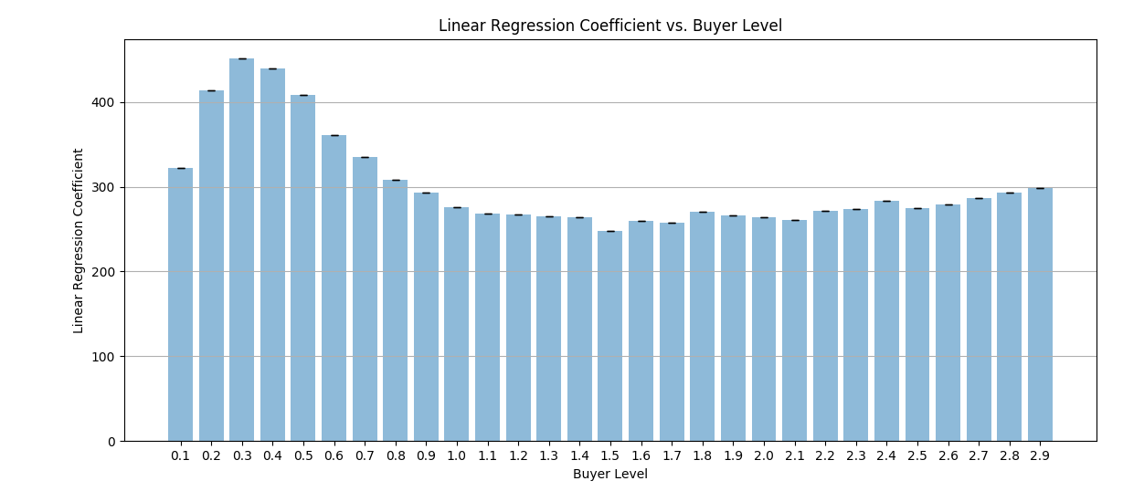
How is the rent gradient affected by buyer level?
Notes:
The initial spike for BL<0.4 is likely due to nearly every buyer getting a cell (recall the one-to-one relationship between BL and % sold), but as the law of diminishing returns kicks in for Buyer Level, more competition for central homes leads to fewer central cells being purchased.
May lead to insight as to why real-world cities have anomalies, would be interesting to examine how rent gradient changes in cities as market composition changes.

Slide 15
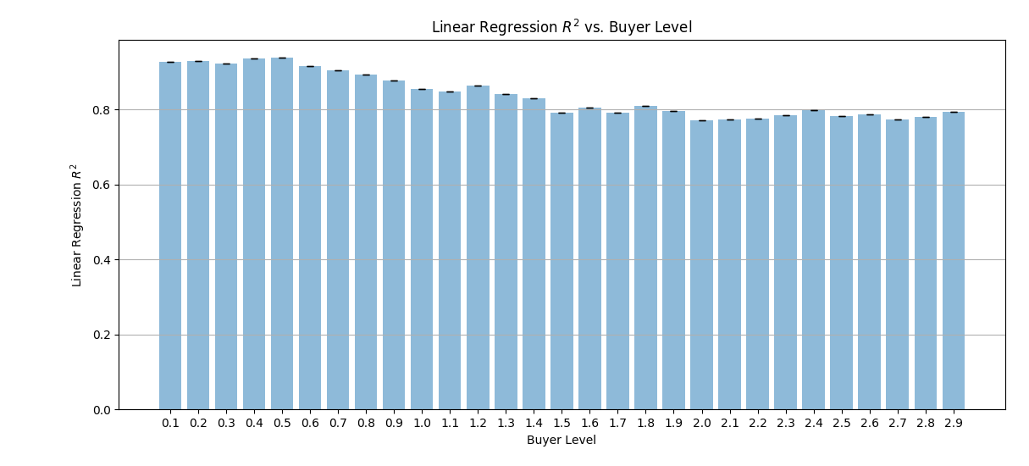
How is the rent gradient affected by buyer level?
Notes:
Less interesting, but adherence to the rent gradient slowly trends down, leveling out.

Slide 16
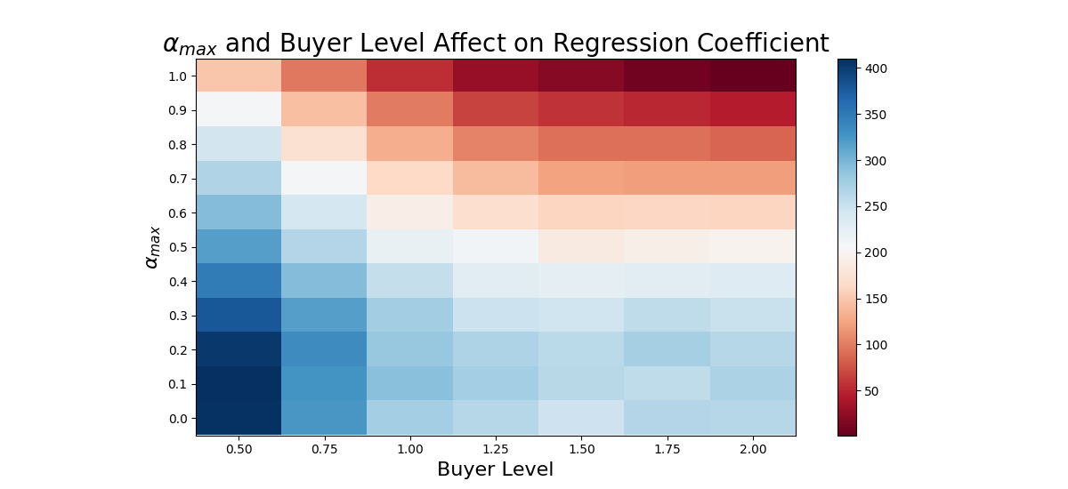
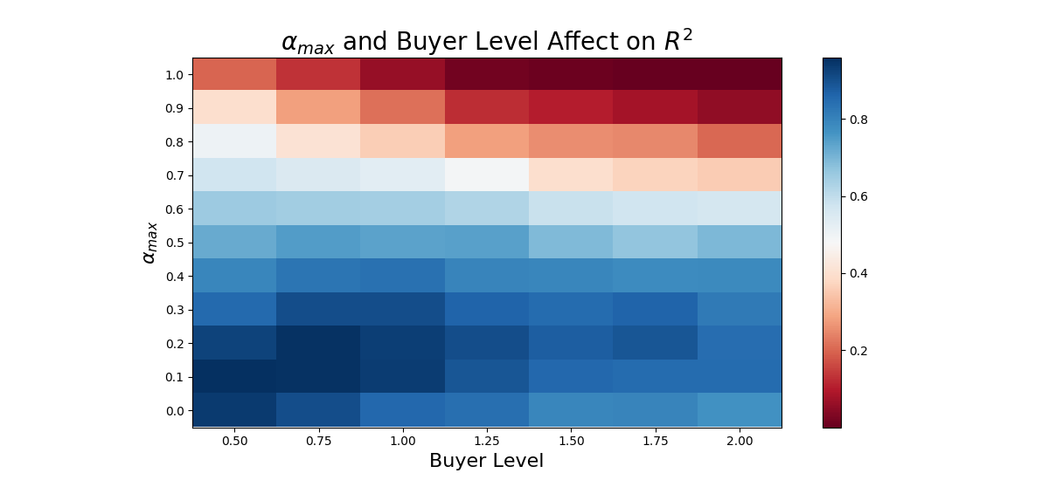
⍺_{max} and Buyer Level vs. Rent Gradient
Notes:
The linear regression coefficient and 𝑅 2 are incredibly high for low 𝛼𝑚𝑎𝑥 and Buyer Level, but as 𝛼𝑚𝑎𝑥 rises both the coefficient and 𝑅 2 fall while Buyer Level rising has a lesser effect on the coefficient and little effect on 𝑅 2 . This suggests that buyer preferences and heterogeneity among buyers may have a larger effect on the rent gradient than the market composition. This makes sense because as 𝑎𝑚𝑎𝑥 rises, mean proximity preference falls, but it would be interesting to see how these relationships change in a model where amenity and proximity preference are no longer zero-sum

Slide 17
Future Directions
Find more data for model verification/validation!
More rigorous sensitivity analysis
Expanded models
coupled housing and land markets (CHALMS)
models that include commerce and industry
Exploring models of polycentricity
Losch’s model of location

Slide 18
References
Dawn Cassandra Parker, Tatiana Filatova, “A conceptual design for a bilateral agent-based land market with heterogeneous economic agents.” Computers, Environment and Urban Systems,Volume 32, Issue 6, 2008. https://doi.org/10.1016/j.compenvurbsys.2008.09.012.
Jackson, Matthew O. and Yariv, Leeat, The Non-Existence of Representative Agents (May 12, 2019). Available at SSRN: https://ssrn.com/abstract=2684776 or http://dx.doi.org/10.2139/ssrn.2684776
Jeon-Young Kang and Jared Aldstadt. 2019. Using multiple scale space-time patterns in variance-based global sensitivity analysis for spatially explicit agent based models. Computers, Environment and Urban Systems 75 (2019), 170 – 183. https://doi.org/10.1016/j.compenvurbsys.2019.02.006
Nicholas Magliocca, Elena Safirova, Virginia McConnell, and Margaret Walls. 2011. An economic agent-based model of coupled housing and land markets (CHALMS). Computers, Environment and Urban Systems 35, 3 (2011), 183 – 191. https://doi.org/10.1016/j.compenvurbsys.2011.01.002
Tatiana Filatova, Dawn Parker and Anne van der Veen. 2009. “Agent-Based Urban Land Markets: Agent's Pricing Behavior, Land Prices and Urban Land Use Change.” Journal of Artificial Societies and Social Simulation vol. 12, no. 1 3. http://jasss.soc.surrey.ac.uk/12/1/3.html
Tatiana Filatova, Alexey Voinov, and Anne van der Veen. 2011. Land market mechanisms for preservation of space for coastal ecosystems: An agent-based analysis. Environmental Modelling Software 26, 2 (2011), 179 – 190. https://doi.org/10.1016/j.envsoft.2010.08.001
W. Alonso. 1964. Location and land use: toward a general theory of land rent. Harvard University Press. https://books.google.com/books?id=-E9ZmQEACAAJ

Slide 19
Questions?
Email: michels9@illinois.edu
Notes:
We

Slide 20
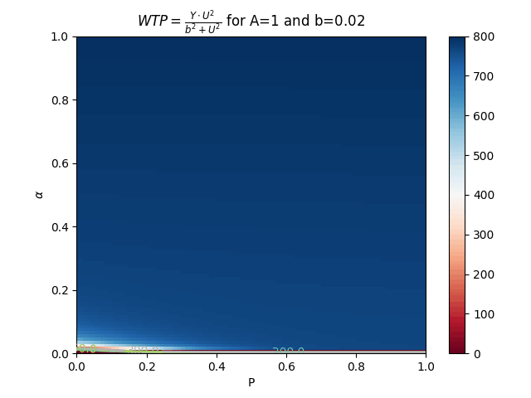
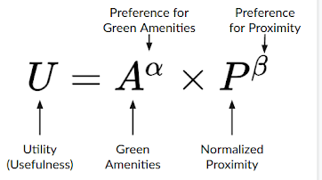
Willing to Pay (WTP)
Recall:
b - “affordability”
Y - budget

Slide 21
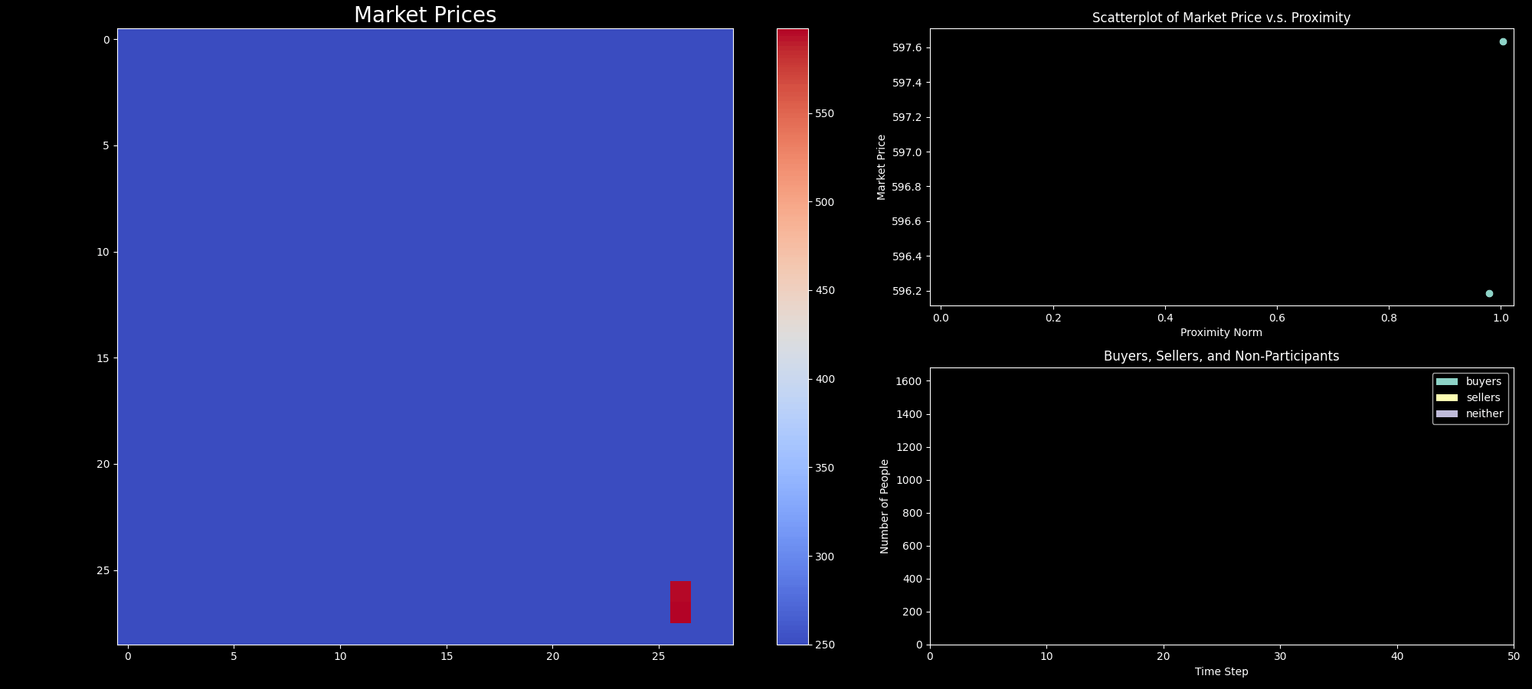
Polycentricity in the ALMA Model
Notes:
Question: how do we extend this model to account for multiple CBDs? I used the the norm, the result can be seen above

